Slide 1
Unit 2
Multithreading

Slide 2
Multithreading
A thread is a lightweight sub-process, the smallest unit of processing.
Threads are independent. If there occurs exception in one thread, it doesn't affect other threads. It uses a shared memory area.
Multithreading is a process of executing multiple threads simultaneously.
Multi-threading enables you to write in a way where multiple activities can proceed concurrently in the same program.

Slide 3
Multithreading - cont
A multi-threaded program contains two or more parts that can run concurrently and each part can handle a different task at the same time making optimal use of the available resources specially when your computer has multiple CPUs.
Multithreading is mostly used in games, animation, etc.

Slide 4
Advantage
It doesn't block the user because threads are independent and you can perform multiple operations at the same time.
Perform many operations together, so it saves time.
Threads are independent, so it doesn't affect other threads if an exception occurs in a single thread.
Multithreading use a shared memory area. They don't allocate separate memory area so saves memory, and
Context-switching between the threads takes less time than process.

Slide 5
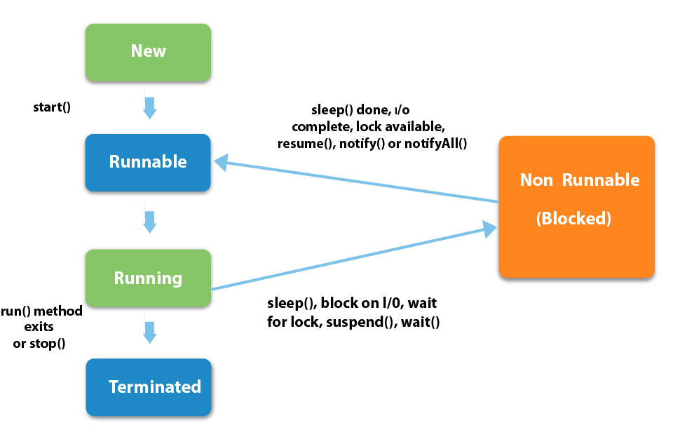
Life cycle of a Thread

Slide 6
Stages of the life cycle
New − A new thread begins its life cycle in the new state. It remains in this state until the program starts the thread. It is also referred to as a born thread.
Runnable − After a newly born thread is started, the thread becomes runnable. A thread in this state is considered to be executing its task.
Waiting − Sometimes, a thread transitions to the waiting state while the thread waits for another thread to perform a task. A thread transitions back to the runnable state only when another thread signals the waiting thread to continue executing.
Timed Waiting − A runnable thread can enter the timed waiting state for a specified interval of time. A thread in this state transitions back to the runnable state when that time interval expires or when the event it is waiting for occurs.
Terminated (Dead) − A runnable thread enters the terminated state when it completes its task or otherwise terminates.

Slide 7
Threads Creation
Threads can be created by using two mechanisms :
Extending the Thread class
Implementing the Runnable Interface
Thread class provide constructors and methods to create and perform operations on a thread. Thread class extends Object class and implements Runnable interface.

Slide 8
Commonly used Constructors of Thread class
Thread()
Thread(String name)
Thread(Runnable r)
Thread(Runnable r,String name)

Slide 9
Thread Methods
Sno | Method | Description
1 | start() | It is used to start the execution of the thread.
2 | run() | It is used to do an action for a thread.
3 | sleep() | It sleeps a thread for the specified amount of time.
4 | currentThread() | It returns a reference to the currently executing thread object.
5 | join() | It waits for a thread to die.
6 | getPriority() | It returns the priority of the thread.
7 | setPriority() | It changes the priority of the thread.
8 | getName() | It returns the name of the thread.
9 | setName() | It changes the name of the thread.
10 | suspend() | It is used to suspend the thread.
11 | resume() | It is used to resume the suspended thread.
12 | stop() | It is used to stop the thread.
13 | destroy() | It is used to destroy the thread group and all of its subgroups.
Etc | ………… | …………..

Slide 10
Creating a Java Thread by Extending a Thread Class
Step 1
You will need to override run( ) method available in Thread class. This method provides an entry point for the thread and you will put your complete business logic inside this method
public void run( )
Step 2
Once Thread object is created, you can start it by calling start() method, which executes a call to run( ) method. Following is a simple syntax of start() method
void start();

Slide 11
Java Thread Example by extending Thread class
class Multi extends Thread{
public void run(){
System.out.println(Thread is running...");
}
public static void main(String args[]){
Multi t1=new Multi();
t1.start();
}
}

Slide 12
Program
Multi1.java
threads_demo.java
withthreads_demo.java
runnableinterface_threads_demo

Slide 13
Creating a Java Thread by implementing Runnable interface
Step 1
As a first step, you need to implement a run() method provided by a Runnable interface. This method provides an entry point for the thread and you will put your complete business logic inside this method. Following is a simple syntax of the run() method −
public void run( )
Step 2
You will instantiate a Thread object using the following constructor −
Thread(Runnable threadObj, String threadName); Where, threadObj is an instance of a class that implements the Runnable interface and threadName is the name given to the new thread.
Step 3
Once a Thread object is created, you can start it by calling start() method, which executes a call to run( ) method. Following is a simple syntax of start() method −
void start();

Slide 14
Java Thread Example by implementing Runnable interface
class Multi3 implements Runnable{
public void run(){
System.out.println("thread is running...");
}
public static void main(String args[]){
Multi3 m1=new Multi3();
Thread t1 =new Thread(m1);
t1.start();
}
}

Slide 15
Example 3 - Thread
class MultithreadingDemo extends Thread
{
public void run()
{ System.out.println ("Thread " + Thread.currentThread().getId() + " is running"); }
}
public class Multithread
{
public static void main(String[] args)
{
int n = 8; // Number of threads
for (int i=0; i<8; i++)
{
MultithreadingDemo object = new MultithreadingDemo();
object.start();
}
}
}

Slide 16
Example 4 - Runnable
class MultithreadingDemo implements Runnable
{
public void run()
{ System.out.println ("Thread " + Thread.currentThread().getId() + " is running"); }
}
class Multithread
{
public static void main(String[] args)
{
int n = 8; // Number of threads
for (int i=0; i<8; i++)
{
Thread object = new Thread(new MultithreadingDemo());
object.start();
}
}
}

